Slide 1

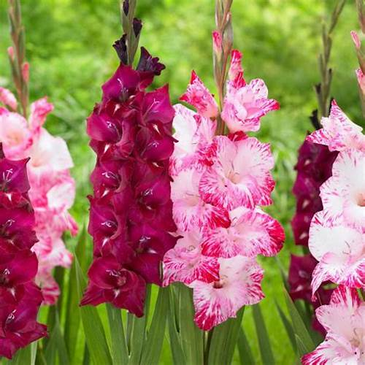
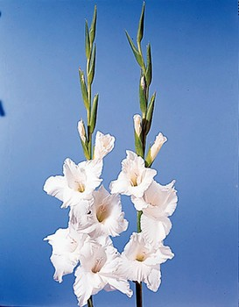

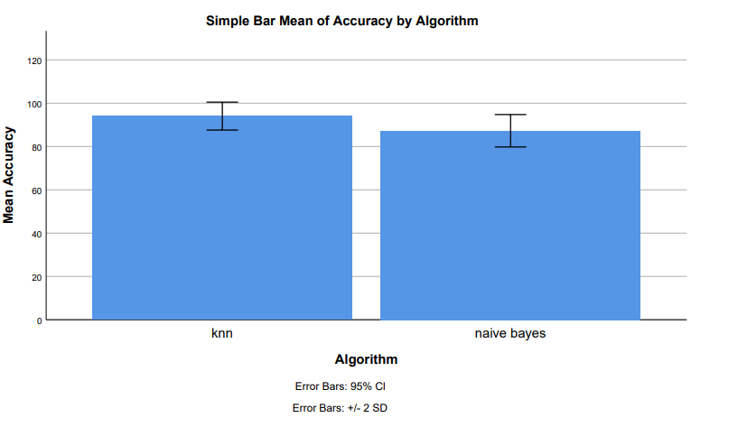
Name: V. Anil Kumar Yadav Register Number: 192110198
Guided by Dr M Rajasekar
Ms. Poorani.S
Guided by Dr. Mary Valantina. G
Improved Accuracy Classification of Sword Lily Petal Features using K Nearest Neighbor with K dimensional tree and Naive Bayes Techniques
INTRODUCTION
The study aims to assess the classification accuracy of sword lily species and explore their diverse floral patterns, scientifically known as Gladiolus, renowned for their vibrant hues and seasonal blooms.
Sword lilies hold significant importance in various industries such as cosmetics and medicine, making the classification of their species crucial both scientifically and practically.
Classification efforts not only enhance our understanding of the natural world but also contribute to biodiversity conservation and sustainable utilization amid environmental challenges.
In contemporary contexts, classification plays a vital role in biodiversity preservation, ecological balance, and the exploration of medical and economic potentials, fostering scientific inquiry.
Sword lilies, like many medicinal plants, find application in pharmaceutical preparations, boasting substantial economic value in cultivation and trade, while also symbolizing cultural significance in ceremonies and rituals across diverse cultures.
The paper focuses on sword lily classification using Machine Learning with scikit tools, addressing the problem statement of identifying sword lily species based on flower attribute measurements.
The study aims to determine which algorithm provides the best accuracy rate in the classification of sword lily species, contributing to advancements in botanical research and classification methodologies.
MATERIALS AND METHODS
Implementation of KNN
Result of Analysis
Data Collection
Data Preprocessing
Feature Selection
Implement the (KNN) algorithm, which classifies a sample based on the majority class of its k nearest neighbors.
Utilize a K Dimensional Tree data structure to efficiently search for the nearest neighbors in the feature space.
Analyze the results obtained from both models and techniques.
Identify strengths and weaknesses of each approach.
Obtain a comprehensive dataset containing sword lily petal features, including measurements such as petal length, width, color, etc. Ensure that the dataset also includes corresponding labels indicating the species of the sword lily
Clean the dataset by removing any outliers, missing values, or irrelevant features that could negatively impact the classification accuracy.
Employ feature selection techniques such as correlation analysis or recursive feature elimination to identify the most relevant features for classification. This step helps in improving computational efficiency and reducing overfitting
Implementation of Naive Bayes
Model Evaluation
Implement the Naive Bayes algorithm, a probabilistic classifier based on Bayes' theorem, assuming independence between features.
Train the Naive Bayes model on the preprocessed dataset
Evaluate the performance of both KNN with K Dimensional Tree and Naive Bayes models using metrics such as accuracy, precision, recall, F1-score, and confusion matrix
RESULTS
K Nearest Neighbor v/s Naïve Bayes
K Nearest Neighbor Algorithm has highest accuracy 92.05% when compared with the Accuracy of Naïve Bayes Algorithm 87.25%.
The standard deviation of K Nearest Neighbor Algorithm and Naïve Bayes Algorithm are 3.220 and 3.740 respectively.
The standard error mean of K Nearest Neighbor Algorithm and Naïve Bayes Algorithm are 0.720 and 0.836 respectively.
These results that K Nearest Neighbor algorithm is best for these research of classification of Sword lily.
Group Statistics table 1
 |  | Levene's test for equality of variances | T- test for equality of means
 |  |  |  |  |  |  |  |  | 95% confidence interval of the difference
 |  | F | Sig. | t | df | Sig. (2-tailed) | Mean difference | Std. Error difference | Lower | Upper
Accuracy | Equal variances assumed Equal variances not assumed | 0.031 | 0.862 | 6.162 | 38 | 0.032 | 6.800 | 1.103 | 4.566 | 9.034
 | Equal variances assumed Equal variances not assumed |  |  | 6.162 | 37.178 | 0.032 | 6.800 | 1.103 | 4.565 | 9.035
 | Algorithm | N | Mean | St. Deviation | Std.Error Mean
Accuracy | K Nearest Neighbor | 20 | 92.50 | 3.220 | 0.720
 | Logistic Regression | 20 | 87.25 | 3.740 | 0.836
Independent sample table
Figure 1. The shown groups in the X-axis are the K Nearest Neighbor algorithm vs Naive Bayes Algorithm and the Y-axis mean accuracy of detection ± 2 standard deviations.
finding the accuracy of the two algorithms, the mean accuracy of K Nearest Neighbor is 92.05% better than the Naive Bayes 87.25% and St. Deviation is slightly lower than the Naive Bayes.
DISCUSSION AND CONCLUSION
The K Nearest Neighbor algorithm achieves a higher accuracy of 92.05% compared to the Naive Bayes algorithm's 87.25% in classifying Sword lily species with the training dataset, as observed in a study by De Smedt .
A statistically significant difference in accuracy (p<0.05) between the two algorithms is noted through an independent test.
Various studies have explored supervised learning approaches for sword lily species prediction, including an efficient Neuro-Fuzzy Approach by Iwendi, Boulouard, and Kryvinska and classification using machine learning methods by Dwork and Roth .
Prof. Joylin Priya Pinto and Prof. Jyothi Shetty's paper is highlighted as exemplary in the classification of Sword lily species, utilizing neural networks and demonstrating superior accuracy compared to other approaches.
Naive Bayes creates a margin of separation between data points for classification, but it may not perform as well with large datasets despite computational efficiency.
Kernel trick can be used to handle large datasets, but it may still have limitations, especially with very large datasets, as noted by Iwendi, Boulouard, and Kryvinska (2023).
K Nearest Neighbor algorithm is distinguished by its characteristic of not requiring a training phase on data, unlike eager learning approaches, and relies on observable data similarities for predictions.
8. K Nearest Neighbor is considered sophisticated and suitable for small to medium-sized datasets, offering a different approach to classification compared to traditional eager learning algorithms.
BIBLIOGRAPHY
Shilpa Sethi, Mamta Kathuria, "Ensemble Feature Reduction Technique for Flower Species Identification", 2023 International Conference on Advanced Computing & Communication Technologies (ICACCTech), pp.721-728, 2023.
Anushee Jain, Chandrasekharan Rajendran, "A Novel Linear Mathematical Model Based Heuristic for a Class of Classification Problem with Non-linearly Separable Data", Applications of Emerging Technologies and AI/ML Algorithms, pp.247, 2023.
N. J. Anasuya, B. N. Yashasvi, P. Puneeth Kumar, B. S. Medha, "Classification of Flower Species Using Machine Learning Algorithm", Proceedings of the International Conference on Cognitive and Intelligent Computing, pp.699, 2022.
Abdullah Albadrani, Faisal Alghayadh, Mohamed A. Zohdy, Esam Aloufi, Richard Olawoyin, "Performance and Predicting of Inbound Logistics Processes Using Machine Learning", 2021 IEEE 11th Annual Computing and Communication Workshop and Conference (CCWC), pp.0790-0795, 2021.
Mohri, Hideo. 2019. Imperial Biologists: The Imperial Family of Japan and Their Contributions to Biological Research. Springer.
Galvin, Kathleen A., Robin S. Reid, Roy H. Behnke Jr, and N. Thompson Hobbs. 2007. Fragmentation in Semi-Arid and Arid Landscapes: Consequences for Human and Natural Systems. Springer Science & Business Media.

